Slide 1



Data science to support sustainable viticulture
Notes:
Hello my name is Bryce Polley I am Kerrie Mengersen's Masters Student who has been based at Waite campus working with the Australian Wine Research Institute, Sustainable Winegrowing Australia and the Food Agility CRC on the project: Data Science to support sustainable Viticulture.

Slide 2
Itinerary
15m Introduction
Who we are
Project Summary
Example yield model
Introduce strawman model
10m Main factors
What are the significant factors
What would we like to include
20m Probability tables
Evaluating and filling out likelihoods
10m Evaluation of the network
Review of likelihoods and network structure
15m Scenario assessment
Discuss potential scenarios
Review how sustainable different scenarios are
15m Discussion
Discuss merits and pitfalls
Potential further adjustments and direction

Slide 3
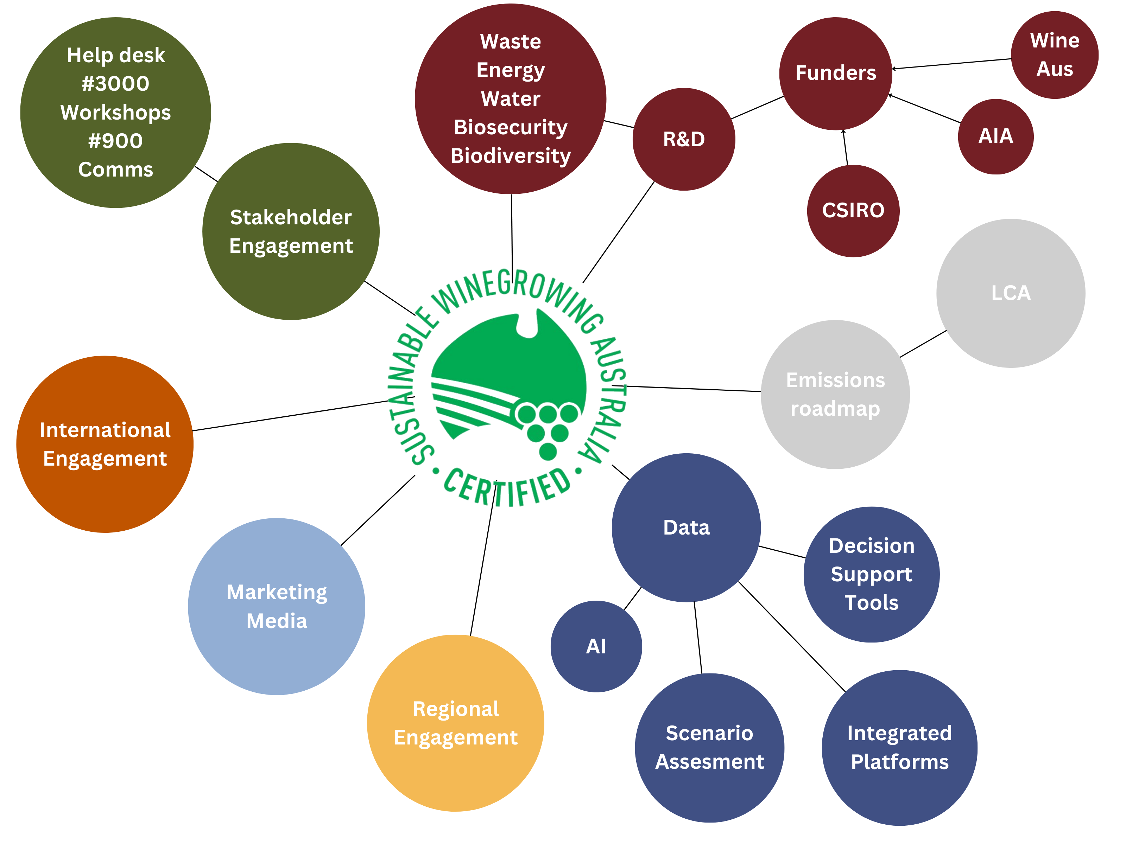
Notes:
As most of you know Sustainable Winegrowing Australia is a central hub of activity
INTRO PINK BUBBLES - One of it’s core functions is the collection of production and resource use data in the areas of waste, energy, water etc. These can be used to inform R&D and there is an important feedback loop here, but it has also enabled us to build broader relationships with funding bodies and other R&D organisations
INTRO GREY BUBBLES – last year we used the Sustainable Winegrowing Australia data to inform the wine industry’s emissions roadmap and Kieran re-analysed the sector’s Life Cycle Analysis
INTRO YELLOW BUBBLES – The Sustainability team uses the program and its data to engage in the regions around their own priority areas and
INTRO THE JADE BUBBLE – earlier this year the data was used in marketing and media campaign around the Impact report
INTRO THE ORANGE BUBBLE – International engagement around the program is continuing to strengthen AND
INTRO THE GREEN BUBBLES – locally, Sustainable Winegrowing Australia provides an opportunity to engage with stakeholders that the AWRI does not often touch – GROWERS – last year the team responded to around 3000 helpdesk queries from growers and more than 900 producers came through sustainability workshops with the team
INTRO THE BLUE BUBBLES – so I am here to talk to you about the data. In particular, my project which uses the Sustainable Winegrowing data and applies AI etc… (add your own words here. Your words below are good)
We aim to use the data to help sustainable efforts
to inform growers with data
Through the investigation of data
The uncovering of synergies, unknown trends and link practices to sustainability
Centre icon -> Make it the trust mark
Figure out an order to introduce the components and how they interact – landing on data at the end

Slide 4
What data do we have?
Resource use
Operational data
Production data
National dataset
Long term data
Water
Fuel
Electricity
Operational Costs
Gross Profit
Cover Crop types
Yield
Price per Tonne
57 Regions
1441 Sites
+10 years
Notes:
Make it really clear
-production data
yield
-resource use metrics
Fuel
electricity
-operational decisions
Cover crops
Financial data
Profit
Operational cost
Summarise the data, 1441 vineyards, 57 regions, 10 years.
Map of aus

Slide 5
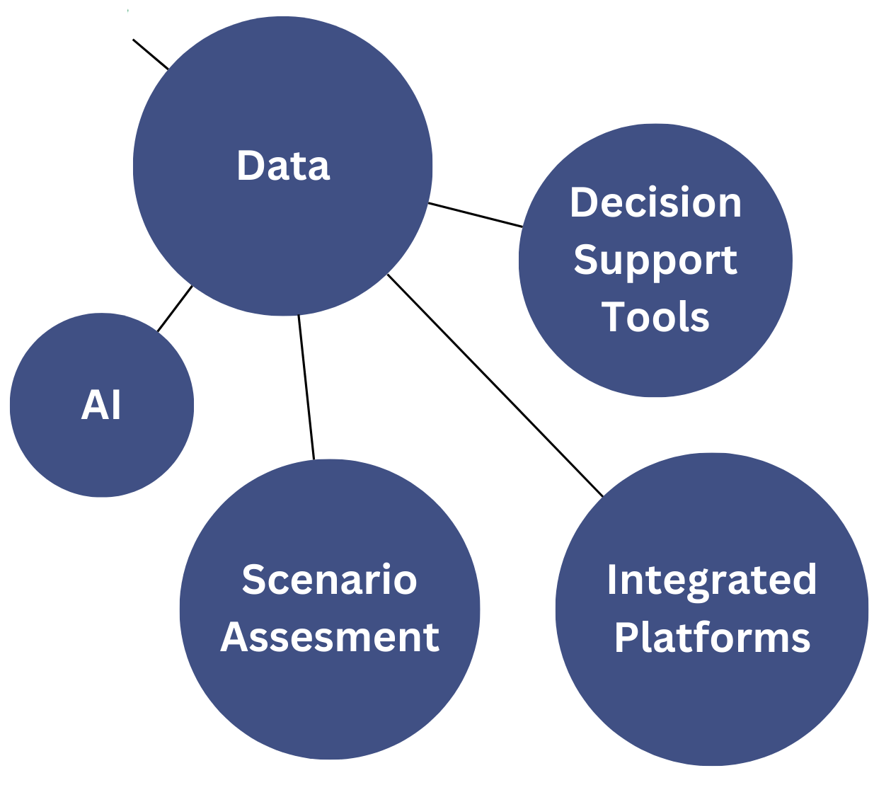
Project Aims
Empirical assessment and comparison
Assisting the industry
Notes:
Describe what is known, a tool to communicate with industry and experts
Data exploration to look at what are new possibilities within the data?
Can we accurately predict things?
Can we explain these predictions?
What were the possible alternative outcomes if things had been done differently?

Slide 6

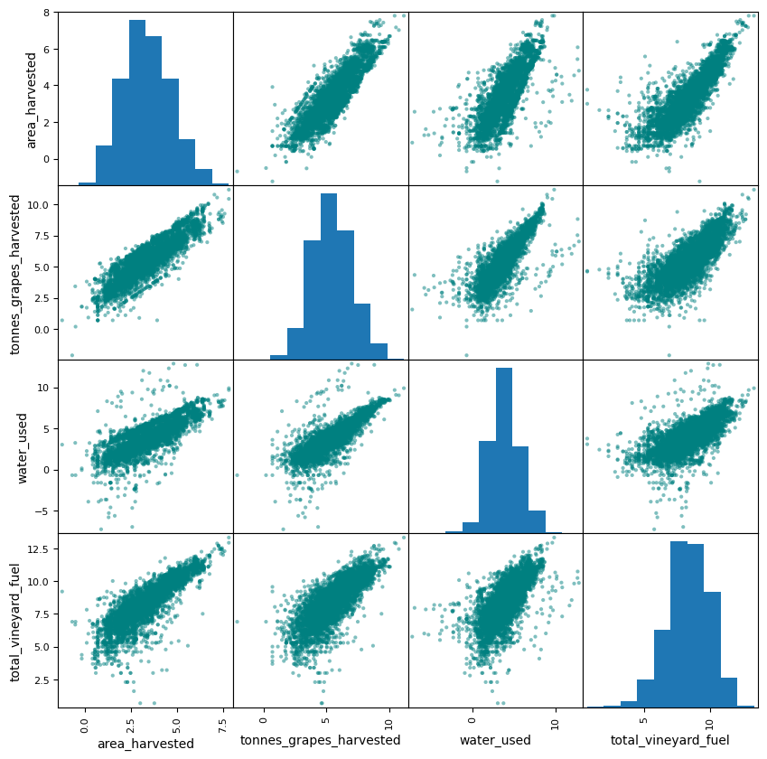
Baseline Models
Anomaly detection
Automation of data input warnings
A tool to communicate with viticulturists
Reality in numbers
Resource use Correlation Matrix
Notes:
The first steps were understanding the data, and how the data translated to the real world. What was it we were looking at.
What values make sense, what are likely input errors, why do people record this?
We were able to help increase the rate at which errors were picked up.

Slide 7
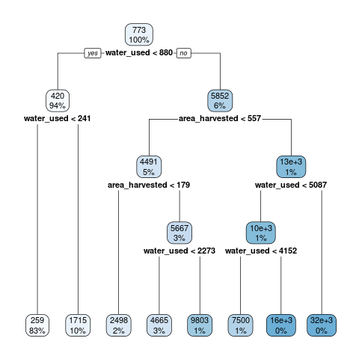
Exploratory Analyses
Operational costs
Gross Profit
Disease Pressures
Regression Tree: Yield
Notes:
More models are under development looking at critical factors to vineyard success such as operational costs and profits. Thus far the most accurate has been the prediction of disease pressure.

Slide 8
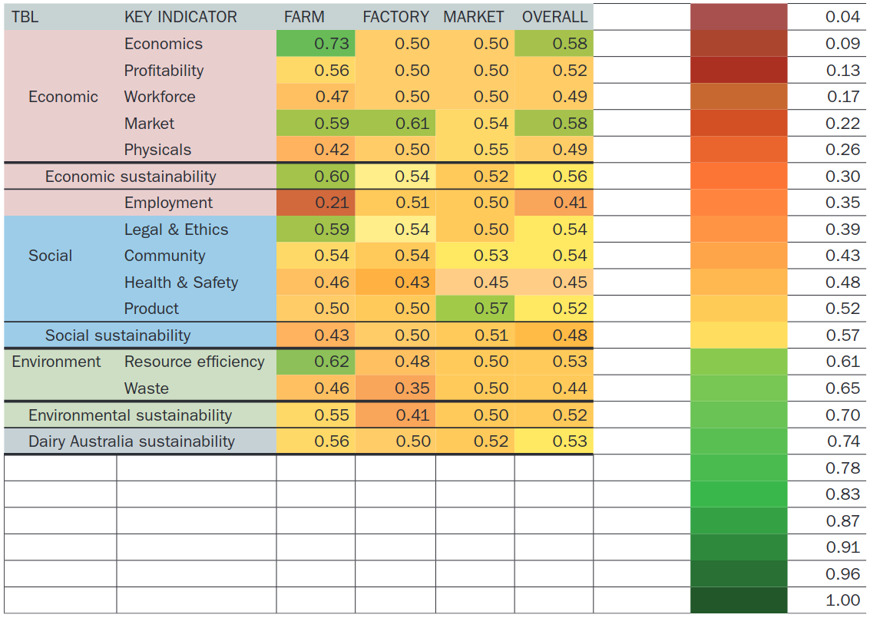
Where are we going with this?
The Strawman model
A strawman model is an initial example that can be used to demonstrate what we want to achieve and can be refined in the workshop by experts.
Why Expert Knowledge?
It helps to link and properly estimate the significance of vineyard factors. It overcomes the limitations of pure data structures, adding a greater level of reality to our findings.
Scenario Assessment
We can use the knowledge we have gained to review a scenario and how its outcomes will potentially change given different circumstances and approaches.
Notes:
The score cards can help to focus efforts appropriately.
Currently we can show where a vineyard sits relative to others but what can they do to effectively increase their sustainability? It is not always as simple as using less fuel, we want to understand what the driving factors behind why any given vineyard performs worse or better in terms of sustainability.

